Slide 1
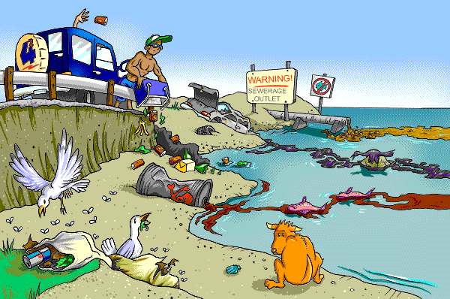
Pollution Prevention and Control
DR R.K FOOLMAUN
Divisional Environment Officer
Pollution Prevention & Control Division

Slide 2
Main themes of presentation
Types of Pollution
Pollution In Facts and Figures
Pollution Control Measures
The PPC Division
Enforcement Mechanisms
Contact Us

Slide 3
MAJOR TYPES OF POLLUTION
AIR POLLUTION
WATER POLLUTION
LAND POLLUTION
NOISE POLLUTION

Slide 4
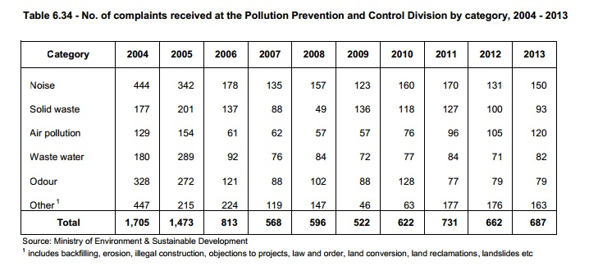
Some Facts & Figures

Slide 5
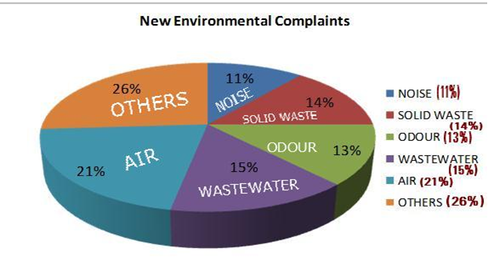
Some Facts & Figures Distribution of Pollution-Related Complaints Received at the Ministry of Environment in 2014

Slide 6
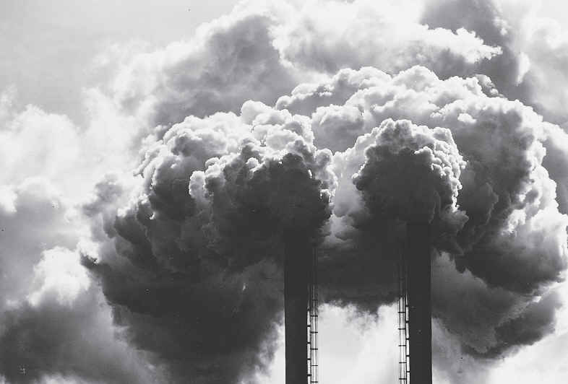
AIR POLLUTION
Air pollution is the introduction of particulates, biological molecules, or other harmful materials into the Earth's atmosphere, causing disease, death to humans, damage to other living organisms such as food crops, or the natural or built environment.

Slide 7
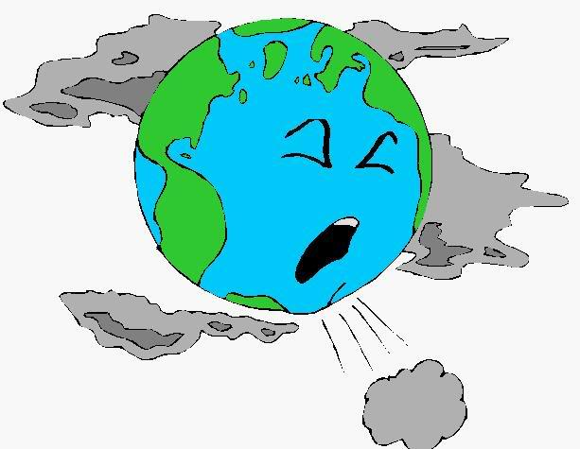
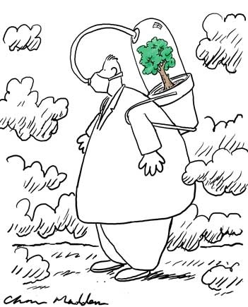
MAJOR AIR POLLUTANTS
CARBON DIOXIDE (CO2)
SULPHUR OXIDES (SOx)
NITROGEN OXIDES (NOx)
CARBON MONOXIDE (CO)
PARTICULATE MATTER (PM)

Slide 8

SOURCES OF AIR POLLUTION
Emissions from Power stations
Emissions from Industrial Processes
Vehicular Emissions
Emissions from Burning of Solid Waste
Emissions from Natural Sources such as Volcanic Eruptions & Forest Fires

Slide 9
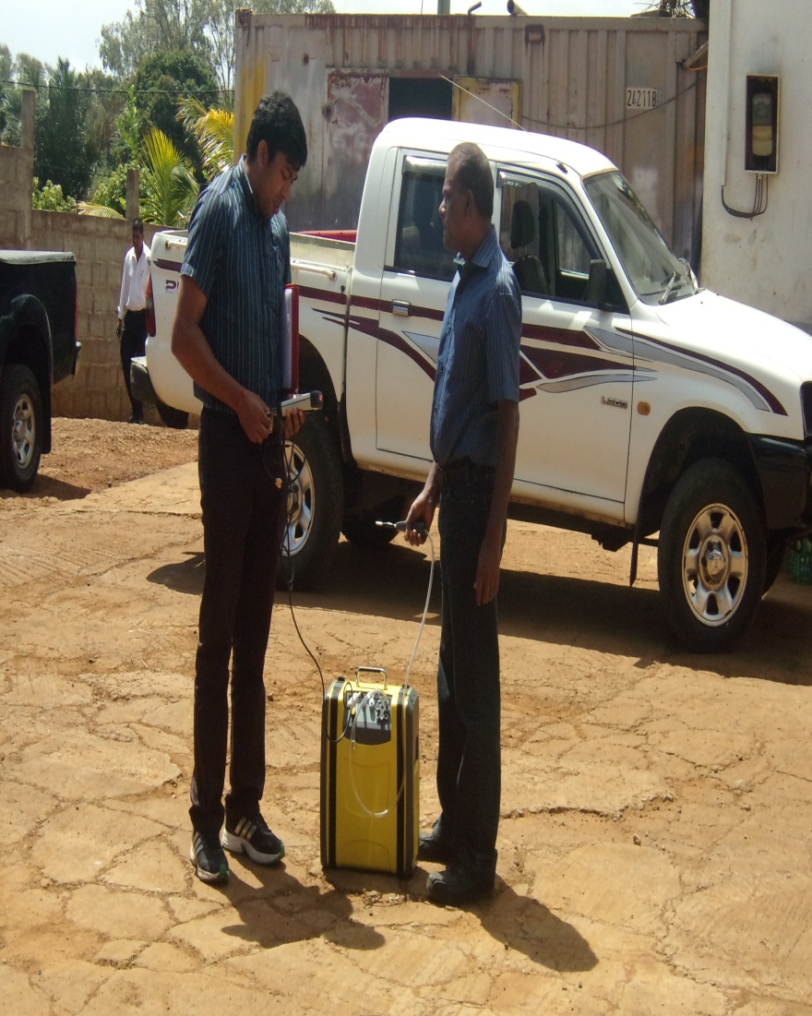
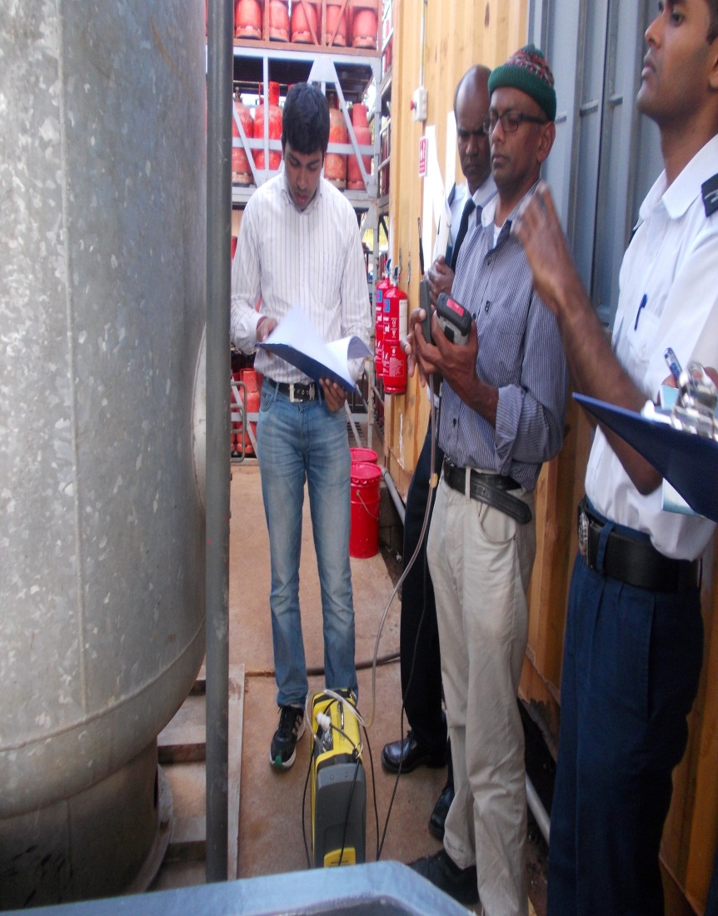
CONTROL OF AIR POLLUTION

Slide 10
Control of air pollution
Standard for Air
Laboratory equipment
– ambient air monitoring station
- portable gas analyser
Smoke control Action plan

Slide 11

Smoke Control Action Plan (SCAP)
AIM
To curb down the number of diesel driven vehicles emitting black smoke
Launched: August 2013
2 Main Components:
- Enforcement (road side checks and contraventions of smoky vehicles by Police de L’Environnement)
- Sensitization campaign (TV and radio)

Slide 12
Smoke Control Action Plan (SCAP)
August 2013 to November 2014
-198 vehicles contravened
-104 Prohibition Notices (above 70%)
- 564 PF 71 have been served

Slide 13

Smoke Control Action Plan (SCAP)

Slide 14
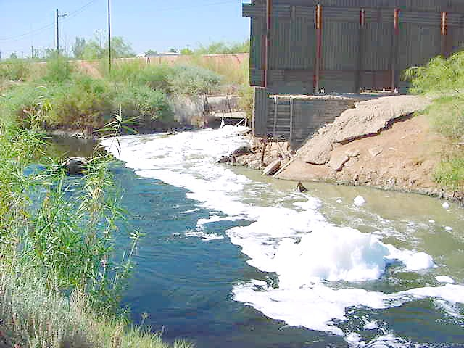
WATER POLLUTION
Water pollution refers to the contamination of water bodies. These may include lakes, rivers, oceans, aquifers and groundwater.

Slide 15
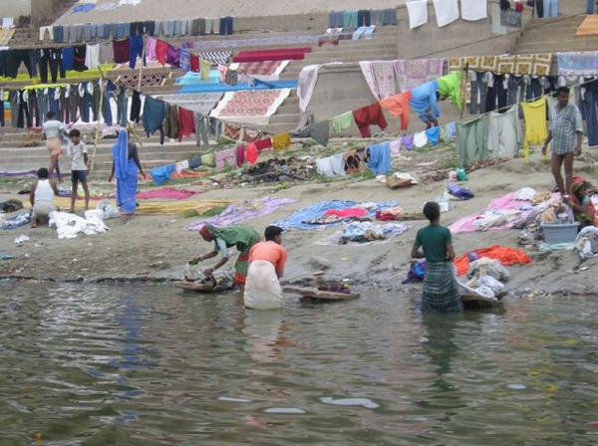
MAJOR WATER POLLUTANTS
Organic Contaminants (Detergents, Herbicides, etc)
Inorganic Contaminants (Heavy Metals, Ammonia, etc)
Solid Waste (Plastics, Paper, Food waste)
Thermal Pollution (Discharge of warm water into water bodies by factories)

Slide 16
SOURCES OF WATER POLLUTION
Sewage
Runoff of Pesticides & Fertilizers
Solid Waste Disposal
Untreated Effluents from Industrial and other activities
Chemical and Oil Spills

Slide 17
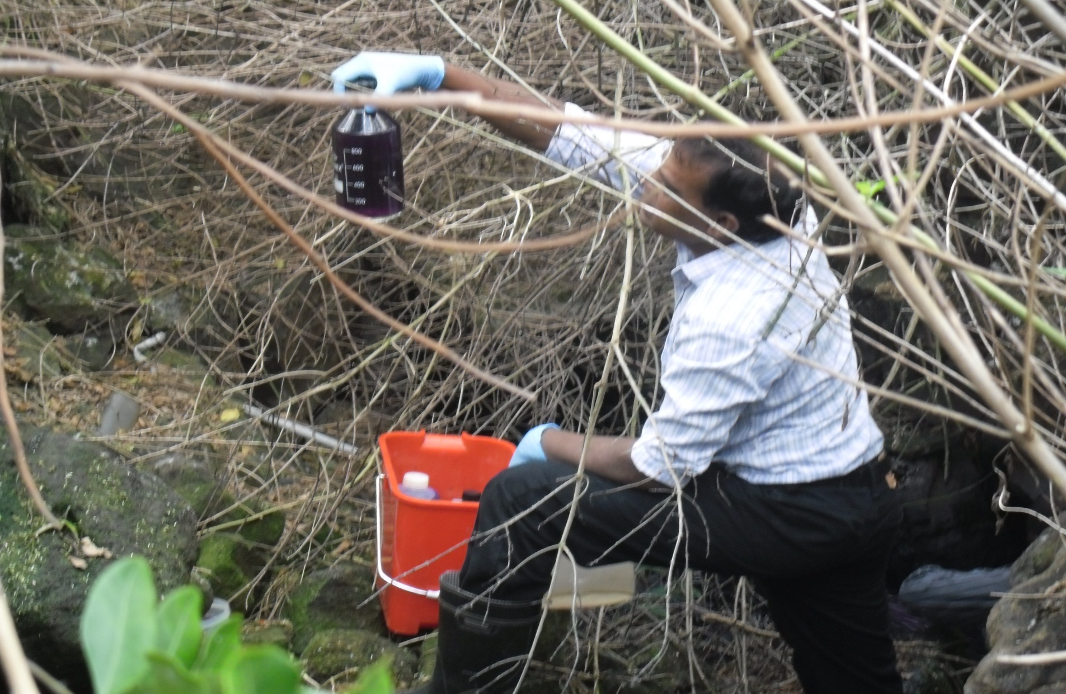
Sampling of Polluted Water By The National Environmental Laboratory

Slide 18
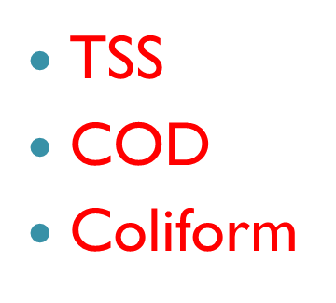
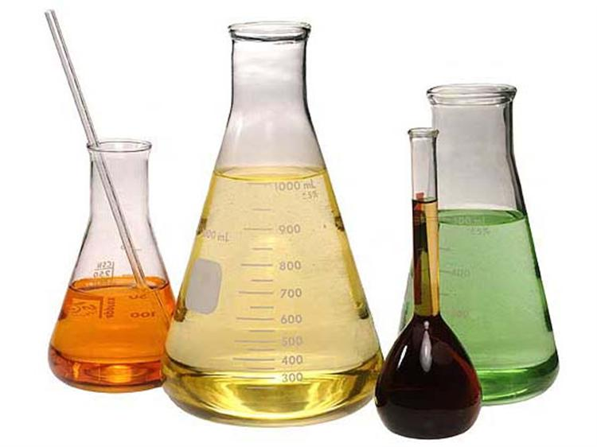
LABORATORY TEST TO DETERMINE WATER QUALITY
Temperature
PH
Conductivity
TDS

Slide 19
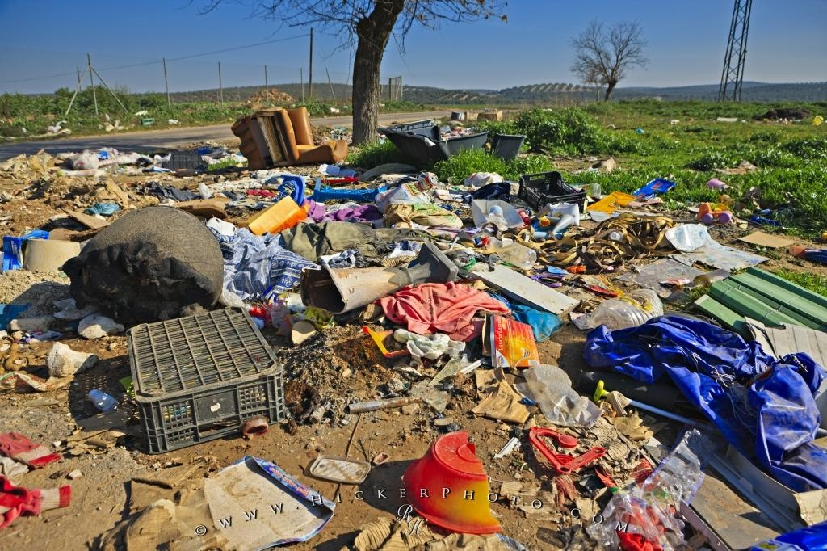
LAND POLLUTION
Land pollution refers to the deposition of solid or liquid waste materials on land or underground in a manner that can contaminate the soil and groundwater, threaten public health, and cause unsightly conditions and nuisances.

Slide 20
SOURCES OF LAND POLLUTION
Domestic Solid Waste (Garbage, Rubbish, Trash)
Construction and Demolition Waste
Agricultural Waste
Industrial Waste

Slide 21
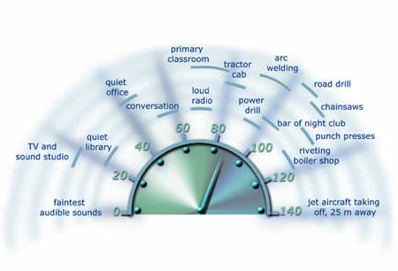
NOISE POLLUTION
Noise is generally defined as unwanted sound.
Sound affects man physically, psychologically and socially
Noise may be continuous or intermittent and may be of high frequency or a low frequency

Slide 22
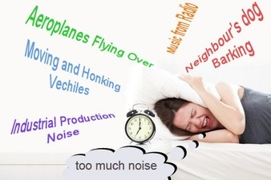
SOURCES OF NOISE POLLUTION
Industrial (power plants, stone crushing, metal workshops, cabinet making);
Multipurpose halls including wedding halls;
Bungalows along the coast;
Places of entertainment, including night clubs;
Road traffic e.g. moving trucks, automobiles, buses, especially those with modified silencer system;
Community noise e.g. radio/TV, loudspeakers, pool houses and alarms;
Animals e.g. dogs, cats, crows;
Use of loud speaker, amplifier, musical instrument, electrical or mechanical device for religious activities;
Aircrafts and speed boats;
Neighbourhood;
Machinery (generator sets, compressors, air conditioning units, boilers, pumps, motors);
Others, including construction works, road infrastructural works, public gathering, vibration, ice cream sellers, vendor shouts.

Slide 23
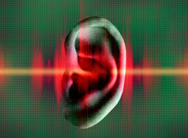
HEALTH EFFECTS OF NOISE POLLUTION
Hearing Loss ( including occupational hearing loss)
Stress
High Blood pressure
Sleep Loss
Distraction
Productivity Loss
Cause Irritability,
headache
Annoying and interfere with communications.

Slide 24

NOISE CONTROL MEASURES
An integrated approach is adopted towards noise pollution control through:
Mass sensitization;
Enforcement of the existing Noise Regulations;
Use of Noise Abatement Technologies;
Research in Novel Technologies;

Slide 25
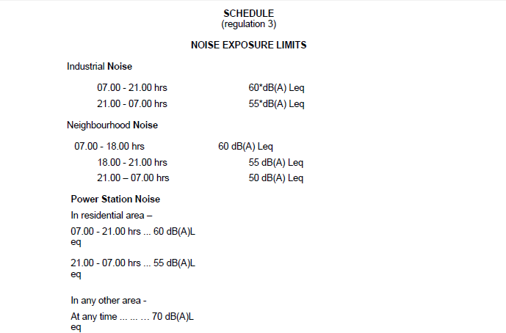
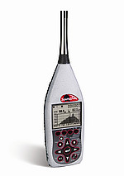
NOISE REGULATIONS IN MAURITIUS
Environmental Standards for Noise (Amendment) Regulations 2003
A Sound Level
Meter Is Used To Measure Noise Levels.

Slide 26
NOISE ABATEMENT TECHNOLOGIES
Installation of barriers between the noise source and the receiver
Use of acoustics in the design of building such as double glazing
Installation of panels or enclosures
Green belt development such as the attenuation of sound levels by plantation of trees and shrubs can

Slide 27
ROLE OF THE POLLUTION PREVENTION & CONTROL (PPC) Division
The PPC Division attends to all environmental complaints received at the Ministry and works in close coordination with the Post-EIA Division, the ICZM Division and the Police de L’Environnement.
Major types of environmental complaints addressed include pollution issues related to air, noise, water, solid waste and odour.
Complaints are usually handled via a mechanism called the Complaint-Handling Protocol.

Slide 28
Enforcing Agencies
Enforcing Agency | Sphere of Responsibility / Pollution medium
Ministry of Health | Noise, Sanitary, Quality Control Of Drinking Water And Odour Nuisances
Ministry of Agro Industry | Pesticide Residue, Soil And Compost
Ministry of Fisheries | Waters In The Coastal Zone, Other Than Waters In The Port
Port Master | Waters In The Port
Wastewater Management Authority | Effluents
Water Resources Unit | inland waters (rivers, rivulets, dams etc..)

Slide 29
Enforcing Agencies
Enforcing Agency | Sphere of Responsibility / Pollution medium
Ministry of Local Government | solid wastes and hazardous wastes
Local Authority | Cleaning of barelands Removal of bulky wastes Cleaning of drains & canals Issue of building and land use permit, trade license etc

Slide 30
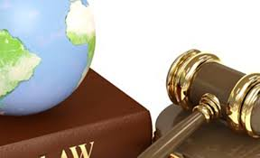
Enforcement tools
Notices
Programme Notice
Enforcement Notice
Prohibition Notice
Stop Order
Eyesore abatement Notice
Fixed penalty

Slide 31

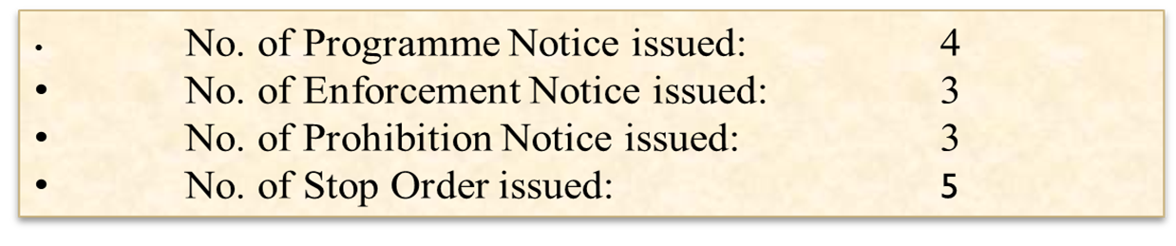
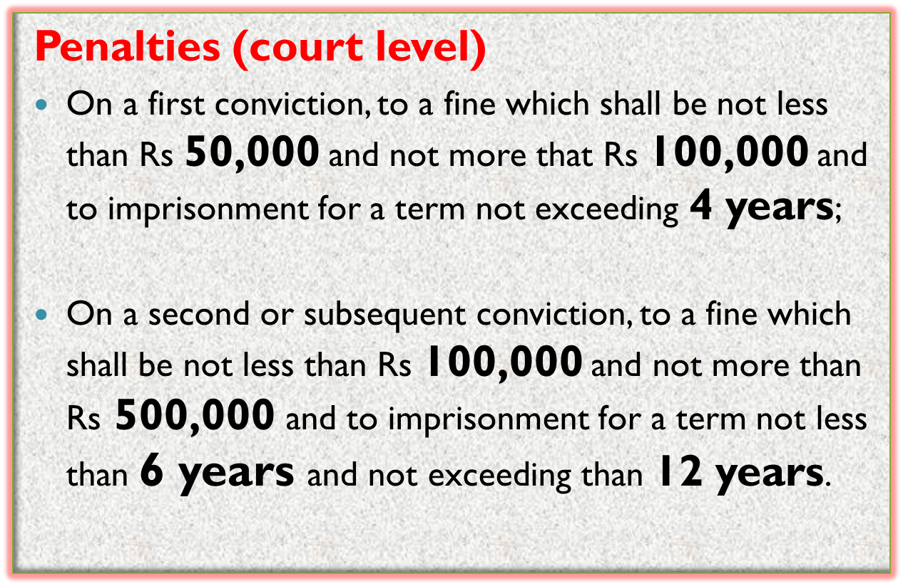


Slide 32
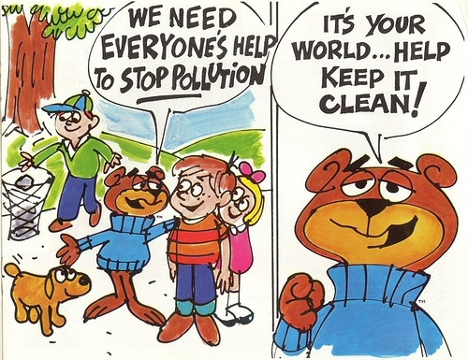

Slide 33


